Slide 1


Smart Resume Screening & Candidate Ranking
A modern recruitment tool designed for faster, objective, and data-driven hiring decisions at scale.
PRESENTED BY:

Slide 2

The Recruitment Bottleneck
Volume Overload: Recruiters face hundreds of applications per position, making manual review completely unscalable.
Time-Consuming Process: Manual screening is slow and error-prone, consuming valuable time that should be spent on candidate interviews.
Hidden Skill Visibility: Key technical competencies remain buried in unstructured PDF text, hindering fast identification.
Lack of Prioritization: Without automated scoring, shortlisting top prospects happens arbitrarily rather than systematically.

Slide 3
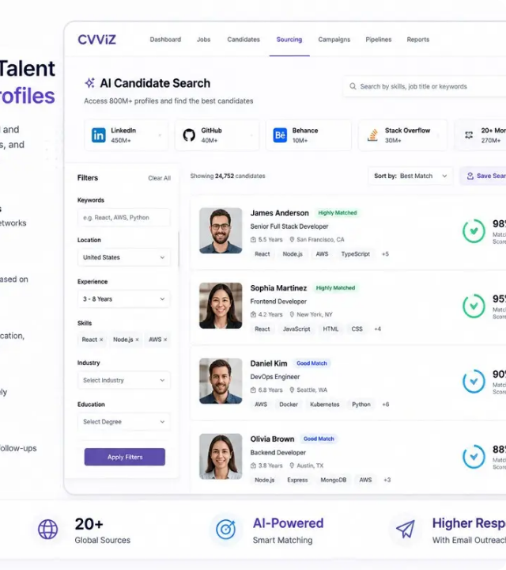
Our Intelligent Solution
Automated Screening
Instantly extracts and analyzes candidate data at scale with zero manual effort required.
Intelligent Skill Matching
Compares candidate resume skillsets directly against job description requirements.
Candidate Ranking
Scores every applicant based on fit percentage to surface top talent immediately.
AI Insights Generation
Produces hiring recommendations, fit summaries, and custom interview prompts.

Slide 4




End-to-End System Workflow
STEP 02
STEP 04
Extract Skills
Parse & Rank
Automated parsing defines target keywords, core competencies, and experience parameters.
System scores candidates and delivers a fully ranked, insight-enriched list instantly.
STEP 01
STEP 03
Enter JD
Upload Resumes
Input job description specifications and key skill requirements into the system.
Batch upload candidate resume files in PDF format for parallel text parsing.

Slide 5




Core Capability Modules
Batch Processing
Skill Scoring
Experience Analysis
AI Insights
Simultaneous PDF text extraction and multi-resume candidate parsing for high-volume pipelines.
Algorithmic skill matching algorithm that ranks candidates objectively by percentage fit.
Deep parsing of project history and career progression to surface background depth.
Automated profile summaries, recommendation ratings, and tailored interview prompts.

Slide 6

Technology Stack
Backend & Processing
Frontend & Deployment
Python + Flask: Powers robust backend business logic and lightweight RESTful API layer.
Bootstrap + Jinja2: Clean, responsive user interface with dynamic server rendering.
PyPDF2 Engine: Fast, structured PDF text parsing and character extraction.
Render + Gunicorn: Enterprise-ready cloud deployment with minimal server configuration.
Open-Source: Zero software licensing overhead with maximum extensibility.
GitHub Versioning: Seamless source code management and collaborative pipeline.

Slide 7
Modular System Architecture
Module File | Primary Purpose | Core Functionality
01 resume_parser.py | Text Extraction | Parses raw PDF resume documents and converts unstructured text into clean data strings.
02 info_extractor.py | Contact Parsing | Extracts candidate entity details including Full Name, Email Address, and Phone Number.
03 matcher.py | Skill Scoring | Evaluates candidate skill clusters against job requirements to compute percentage match score.
04 project_extractor.py | Experience Analysis | Surfaces career achievements, technical project details, and total relevant work tenure.
05 recommendation.py | AI Decision Support | Synthesizes candidate report into actionable status (Hire/Maybe/Reject) and custom interview questions.

Slide 8

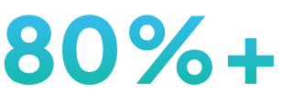
Actionable Candidate Deliverables
Complete Structured Profile: Instant access to contact information, experience summaries, and skill gap analysis.
Match Percentage Fit: Every applicant receives a normalized numerical score based on JD alignment.
Hiring Recommendations: Clear status classification (Hire / Maybe / Reject) backed by analytical reasoning.
Screening Time Saved
Recruiters jump straight to interviewing top-ranked prospects.
Tailored Interview Prompts: System automatically suggests targeted technical questions based on identified skill gaps.

Slide 9



Advantages & System Constraints
Key Advantages
System Constraints
Scalability: Instantly processes massive resume batches during active hiring drives.
PDF Layout Sensitivity: Highly complex or image-scanned PDFs may impact parsing accuracy.
Unbiased Evaluation: Objective skill scoring eliminates initial recruiter screening bias.
Human-in-the-Loop: Serves as decision support; final hiring calls remain with recruiters.
Instant Insights: Generates concise summaries for quick executive hiring reviews.
Keyword Dependency: Relies on recognized keyword patterns; unlisted synonyms require dictionary expansion.

Slide 10








Future Development Roadmap
LLM Integration
Proficiency Scoring
Portfolio Scraper
Recruiter Portal
OCR Engine
Deep semantic understanding beyond keywords using advanced AI models.
Estimates skill expertise levels rather than simple presence detection.
Validates candidate claims by inspecting GitHub & online portfolios.
Persistent database dashboard to manage multi-role candidate pipelines.
Optical character recognition to parse scanned images and physical docs.

Slide 11
Questions & Discussion
Thank you for reviewing the Smart Resume Screening Presentation.
PRESENTED BY AYUSH | AI RECRUITMENT SUITE

